Slide 1

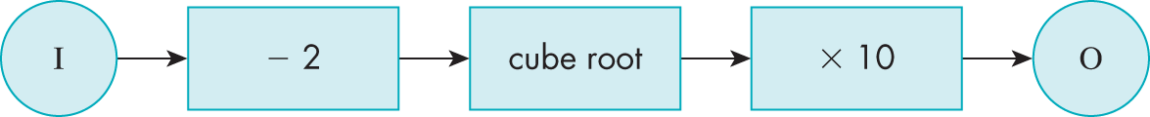


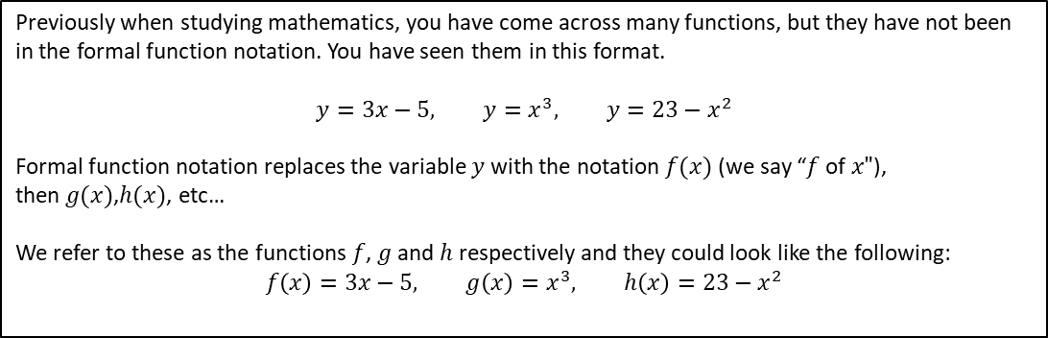


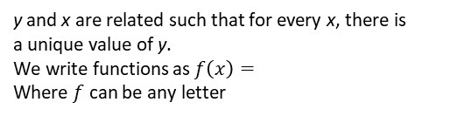


Subtopic 5 – Functions
LEARNING OUTCOME: To work with functions.
Objectives:
Keywords:
Function
Inverse
Composite
To understand what functions are
To be able to find inverse functions.
To be able to work with composite functions.
Previously when studying mathematics, you have come across many functions, but they have not been in the formal function notation. You have seen them in this format.
$$y=3x−5, y=x^{3}, y=23−x^{2}$$
Formal function notation replaces the variable $y$ with the notation $f(x)$ (we say “$f$of$x"$), then$g(x)$,$h(x)$, etc…
We refer to these as the functions$f$, $g$ and $h$ respectively and they could look like the following:
$$f\left(x\right)=3x−5, g\left(x\right)=x^{3}, h\left(x\right)=23−x^{2}$$
Definition
Characteristics
Function, in mathematics, an expression, rule, or law that defines a relationship between one variable (the independent variable) and another variable (the dependent variable).
y and x are related such that for every x, there is a unique value of y.
We write functions as $f\left(x\right)=$
Where $f$ can be any letter
Examples
Functions
Non - Examples
$$f\left(x\right)=4x+3$$
$$y=3$$
$$4x+7y$$
$$g\left(x\right)=\frac{1}{x}$$
$$h\left(x\right)=x^{2}+3$$
$$x≡3y$$
Prior Knowledge Check
1. Use the function machine to find the output for each input.
2. Use the function machine to find the input for each output.
i. 11
i. 18
ii. 26
ii. 0
iii. – 4
iii. 500
iv. 1
iv. 3
3. Use the function machine to find the input for each output.
i. 30
iii. 18
ii. 60

Slide 2







Substituting into Functions
Example 1 - I do…
Example 2 - We do…
Example 3- You do…
$$f\left(x\right)=2x+1$$
Find:
$f(3)$
Substitute 3 into the function.
$f\left(3\right)=2\left(3\right)+1$
$$f\left(3\right)=$$
$$f\left(x\right)=2x+1$$
Find:
$f(−7)$
Substitute -7 into the function.
$f\left(−7\right)=$
$$f\left(x\right)=x^{2}−2$$
Find:
$f(8)$
$f\left(8\right)=$
INDEPENDENT PRACTICE
1. f(x) = 2x² + 7 Find the value of each of these
$f\left(3\right)$
$f\left(11\right)$
$f\left(−2\right)$
$f\left(30\right)$
$f\left(−30\right)$
$f\left(\sqrt{3}\right)$
2. g(x) = 25 - x² Find the value of each of these
$g\left(4\right)$
$g\left(−8\right)$
$g\left(9\right)$
$g\left(−9\right)$
$g\left(\sqrt{13}\right)$
$g\left(−0.4\right)$
3. f(x) = $2x2 +3x$ Find the value of each of these
$f\left(−6\right)$
$f\left(4\right)$
4. g(x) = $x2 +3x−7$ Find the value of each of these
$g\left(3\right)$
$g\left(−4\right)$

Slide 3


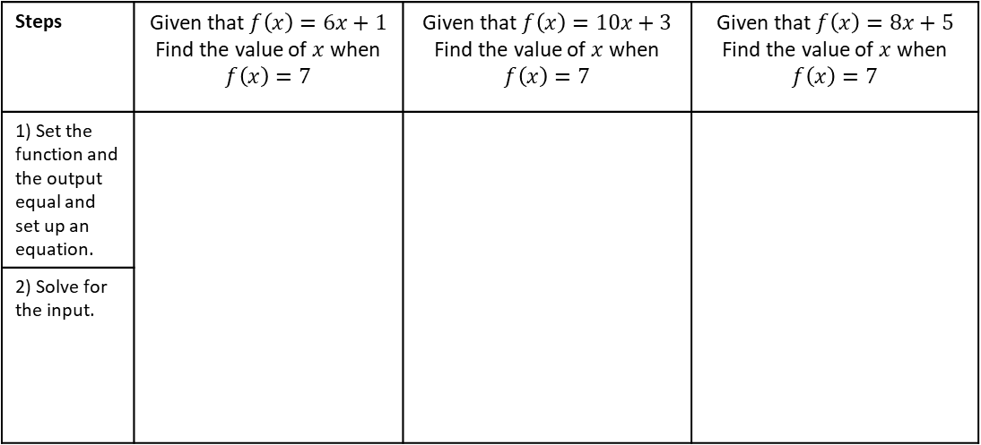






FINDING THE INPUT
Example 5 - We do…
Example 6 - You do…
Example 4- I do…
Example 6- You do…
Steps | Given that $f\left(x\right)=6x+1$ Find the value of $x$ when $f\left(x\right)=7$ | Given that $f\left(x\right)=10x+3$ Find the value of $x$ when $f\left(x\right)=7$ | Given that $f\left(x\right)=8x+5$ Find the value of $x$ when $f\left(x\right)=7$
1) Set the function and the output equal and set up an equation.
2) Solve for the input.
INDEPENDENT PRACTICE
5) Given that $f\left(x\right)=6x+1,$ find the value of $x$ when:
$$a) f\left(x\right)=1$$
$$b) f\left(x\right)=4$$
c$) f\left(x\right)=3$
d$) f\left(x\right)=10$
$$e) f\left(x\right)=−3$$
$$f) f\left(x\right)=−4$$
g$) f\left(x\right)=−2$
h$) f\left(x\right)=−10$

Slide 4










Example 7- I do…
Example 8 - We do…
Example 9- You do…
$$f\left(x\right)=2x+1$$
Find:
$2f(x)$
$$f\left(x\right)=3x−1$$
Find:
$3f(x)$
$$f\left(x\right)=x^{2}−2$$
Find:
$3f(x)$
INDEPENDENT PRACTICE
1) $f\left(x\right)=x^{2}+6$
Find:
a) $2f(x)$
b) $4f(x)$
2) $f\left(x\right)=3x+2$
Find:
a) $2f(1)$
b) $3f(2)$
Example 10- I do…
Example 11 - We do…
Example 12- You do…
$$f\left(x\right)=2x+1$$
Find:
$f\left(x+1\right)$
$$f\left(x\right)=3x−1$$
Find:
$f(x−2)$
$$f\left(x\right)=x^{2}−2$$
Find:
$f(x+6)$
INDEPENDENT PRACTICE
1) $f\left(x\right)=5x−3$
Find:
a) $f(x+2)$
b) $f(x−4)$
2) $f\left(x\right)=x^{2}+5$
Find:
a) $f(x+2)$
b) $f(x−1)$

Slide 5











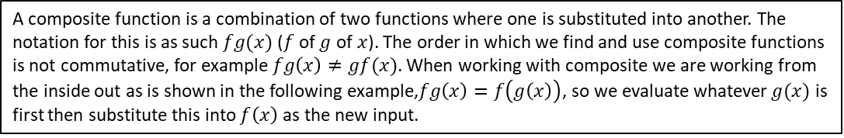
COMPOSITE FUNCTIONS
A composite function is a combination of two functions where one is substituted into another. The notation for this is as such $fg(x)$ ($f$ of $g$ of$x$). The order in which we find and use composite functions is not commutative, for example$fg\left(x\right)≠gf(x)$. When working with composite we are working from the inside out as is shown in the following example,$fg\left(x\right)=f\left(g\left(x\right)\right)$, so we evaluate whatever $g(x)$ is first then substitute this into $f\left(x\right)$ as the new input.
Example 13- I do…
Example 14 - We do…
Example 15 - You do…
Steps
1) Substitute the number into the first function.
2) Substitute the output into the second function.
$$f\left(x\right)=2x$$
$$g\left(x\right)=x+1$$
Find $fg(2)$
$$f\left(x\right)=3x$$
$$g\left(x\right)=x+3$$
Find $fg(2)$
$$f\left(x\right)=3x$$
$$g\left(x\right)=x−2$$
Find $fg(3)$
INDEPENDENT PRACTICE
7. Given that $f\left(x\right)=2x$and $g\left(x\right)=x+1$ Find:
a) $fg(3)$
b) $fg(4)$
c) $gf(2)$
d) $gf(3)$
e) $fg(3)$
f) $ff(2)$
g) $gg(2)$
h) $ggg(3)$

Slide 6


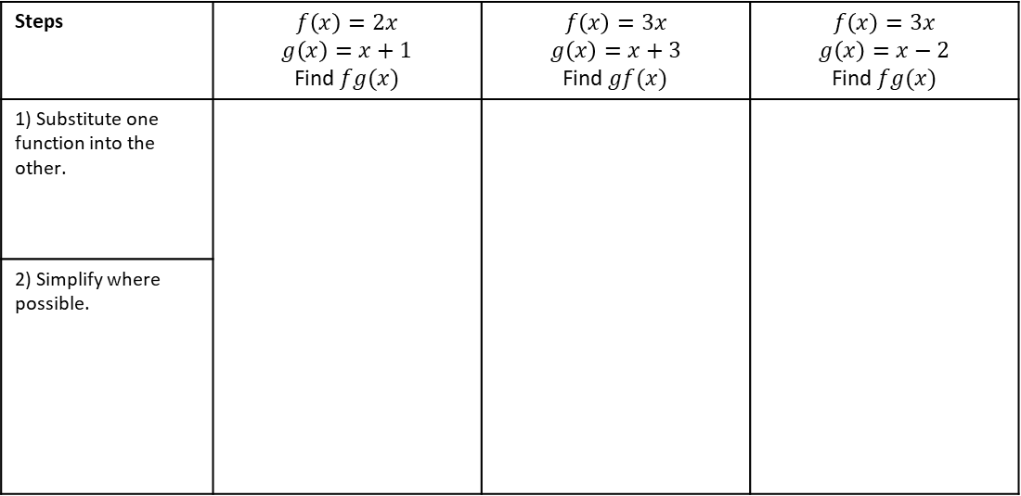







8. Given that $f\left(x\right)=2x$and $g\left(x\right)=x−1$ Find:
a) $fg(2)$
b) $fg(4)$
c) $gf(2)$
d) $gf(5)$
Example 16- I do…
Example 17 - We do…
Example 18 - You do…
Steps | $$f\left(x\right)=2x$$ $$g\left(x\right)=x+1$$ Find $fg(x)$ | $$f\left(x\right)=3x$$ $$g\left(x\right)=x+3$$ Find $gf(x)$ | $$f\left(x\right)=3x$$ $$g\left(x\right)=x−2$$ Find $fg(x)$
1) Substitute one function into the other.
2) Simplify where possible.
INDEPENDENT PRACTICE
Find the value of these composite functions algebraically.
9) $f\left(x\right)=2x$
$$g\left(x\right)=x+1$$
a) $fg(x)$
b) $gf(x)$
c) $ff(x)$
d) $gg(x)$

Slide 7














INDEPENDENT PRACTICE
Find the value of these composite functions algebraically.
10) $f\left(x\right)=3x$
$$g\left(x\right)=x+1$$
a) $fg(x)$
b) $gf(x)$
c) $ff(x)$
d) $gg(x)$
11) $f\left(x\right)=5x$
$$g\left(x\right)=3x−2$$
e) $fg(x)$
f) $gf(x)$
g) $ff(x)$
h) $gg(x)$
12) $f\left(x\right)=x^{2}$
$$g\left(x\right)=3x−3$$
i) $fg(x)$
j) $gf(x)$
k) $ff(x)$
l) $gg(x)$

Slide 8




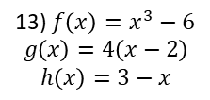






13) $f\left(x\right)=x^{3}−6$
$$g\left(x\right)=4\left(x−2\right)$$
$$h\left(x\right)=3−x$$
m) $gf(x)$
n) $hg(x)$
o) $fh(x)$
p) $gg(x)$
14) $f\left(x\right)=2x+1$ $$g\left(x\right)=\frac{1}{x}$$
q) $fg(x)$
r) $gf(x)$
s) $ff(x)$
t) $gg(x)$
15) Let $f\left(x\right)=x+1$ and $g\left(x\right)=x^{2}+1$.
If $gf\left(x\right)=17$, determine the possible values of $x$

Slide 9


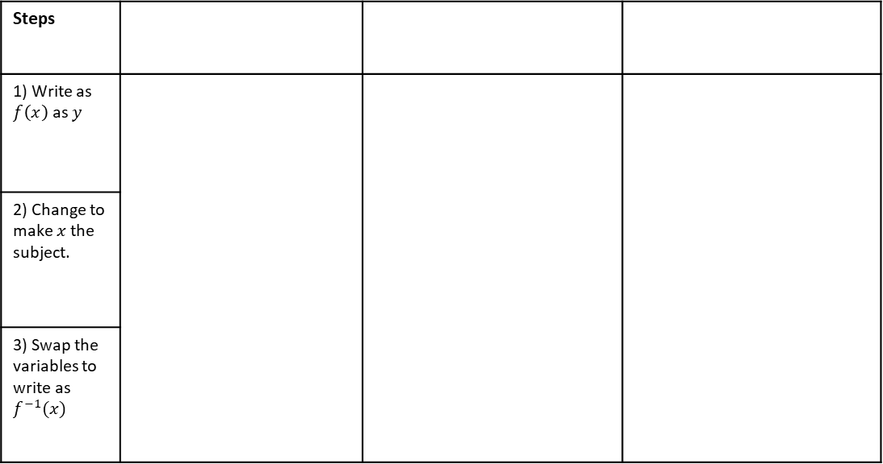

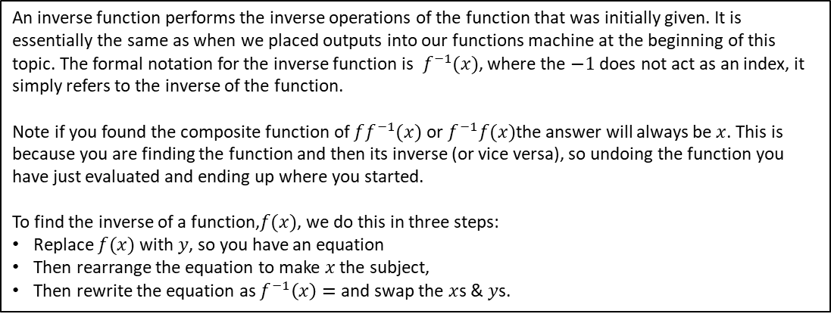

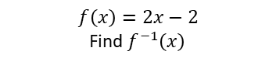


INVERSE FUNCTIONS
An inverse function performs the inverse operations of the function that was initially given. It is essentially the same as when we placed outputs into our functions machine at the beginning of this topic. The formal notation for the inverse function is$f^{−1}(x)$, where the $−1$ does not act as an index, it simply refers to the inverse of the function.
Note if you found the composite function of $ff^{−1}(x)$ or $f^{−1}f(x)$the answer will always be$x$. This is because you are finding the function and then its inverse (or vice versa), so undoing the function you have just evaluated and ending up where you started.
To find the inverse of a function,$f(x)$, we do this in three steps:
Replace $f(x)$ with $y$, so you have an equation
Then rearrange the equation to make $x$ the subject,
Then rewrite the equation as $f^{−1}\left(x\right)=$ and swap the $x$s & $y$s.
Example 19- I do…
Example 20 - We do…
Example 21- You do…
Steps
1) Write as $f\left(x\right)$ as $y$
2) Change to make $x$ the subject.
3) Swap the variables to write as $f^{−1}(x)$
$$f\left(x\right)=2x$$
Find $f^{−1}\left(x\right)$
$f\left(x\right)=\frac{x−3}{2−x}$, find $f^{−1}\left(x\right)$
$$f\left(x\right)=2x−2$$
Find $f^{−1}\left(x\right)$
INDEPENDENT PRACTICE
6. Find the inverse functions $f^{−1}(x)$ of the following functions
a) $f\left(x\right)=4x$
b) $f\left(x\right)=5x$
c) $f\left(x\right)=x+7$
d) $f\left(x\right)=7x+2$

Slide 10













i) $f\left(x\right)=x+5$
j) $f\left(x\right)=x−1$
k) $f\left(x\right)=x−2$
l) $f\left(x\right)=x−3$
m) $f\left(x\right)=4x−5$
n) $f\left(x\right)=x^{3}+2$
o) $f\left(x\right)=\frac{10}{x+1}$
p) $f\left(x\right)=10−2x$
q) $f\left(x\right)=\frac{x−7}{6}$
r) $f\left(x\right)=\frac{3}{x}+5$
s) $f\left(x\right)=\frac{x+2}{3x−5}$
t) $f\left(x\right)=\frac{3x+8}{4x−3}$
u) Prove that if $f\left(x\right)=\frac{ax+b}{cx−a}$ then $f^{−1}\left(x\right)=\frac{ax+b}{cx−a}$

Slide 11
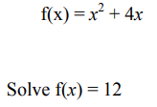
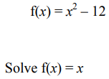
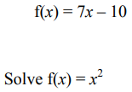

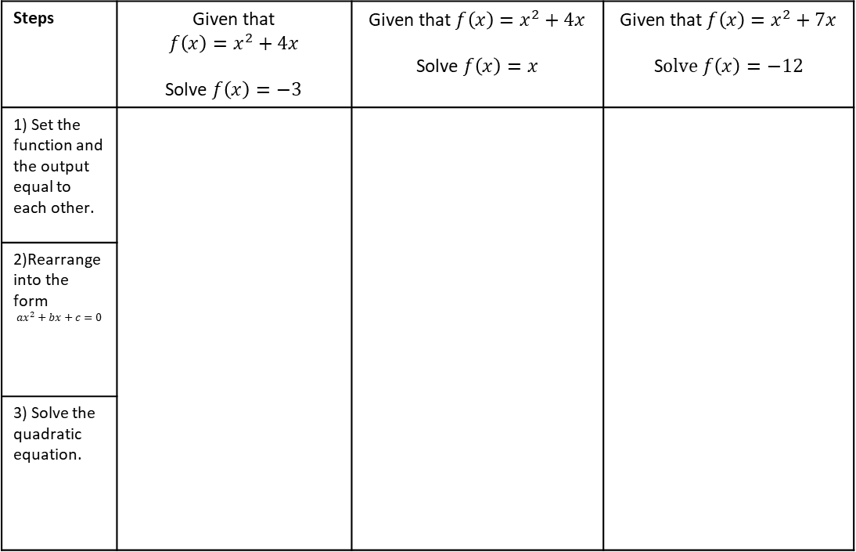

SOLVING QUADRATIC EQUATIONS WITH FUNCTIONS
Example 22 - I do…
Example 23 - We do…
Example 24- You do…
Steps | Given that $$f\left(x\right)=x^{2}+4x$$ Solve $f\left(x\right)=−3$ | Given that $f\left(x\right)=x^{2}+4x$ Solve $f\left(x\right)=x$ | Given that $f\left(x\right)=x^{2}+7x$ S$olve f\left(x\right)=−12$
1) Set the function and the output equal to each other.
2)Rearrange into the form $$ax^{2}+bx+c=0$$
3) Solve the quadratic equation.
INDEPENDENT PRACTICE
16) Solve each quadratic equation from the function.
a)
b)
c)
$x=$ or $x=$
$x=$ or $x=$
$x=$ or $x=$

Slide 12
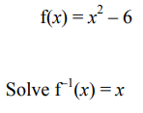
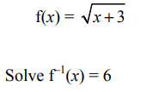
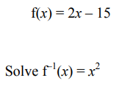
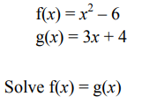
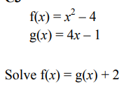
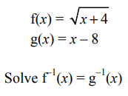


d)
e)
f)
$x=$ or $x=$
$x=$ or $x=$
$x=$ or $x=$
g)
h)
i)
$x=$ or $x=$
$x=$ or $x=$
$x=$ or $x=$

Slide 13
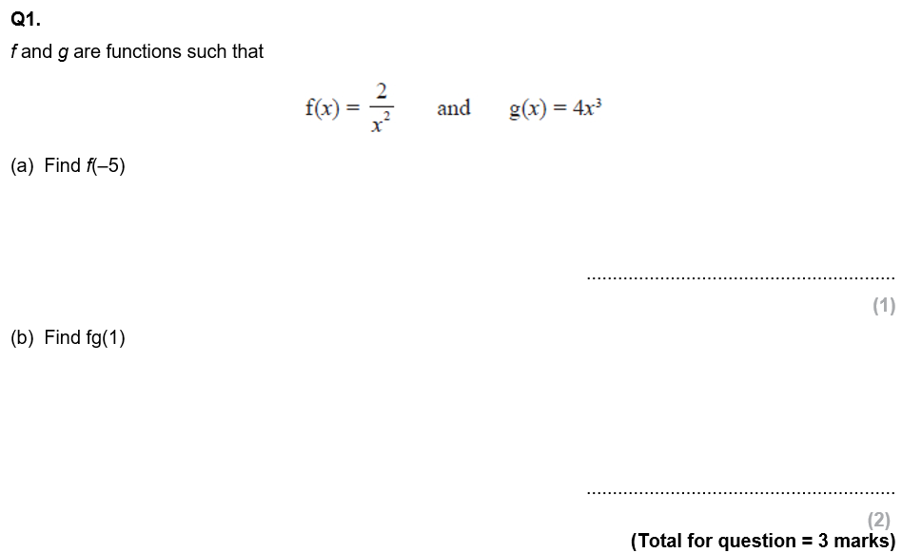
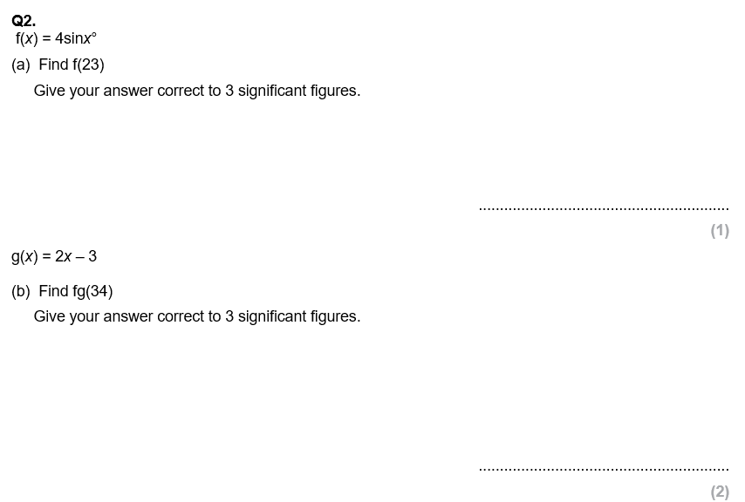
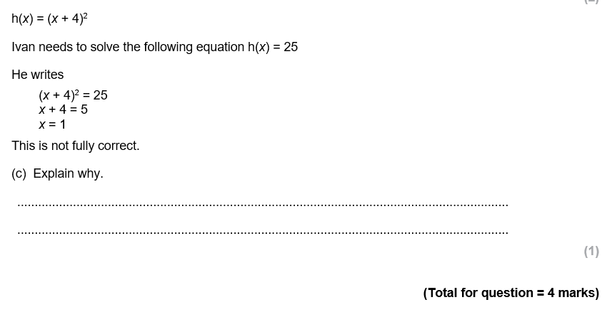
GCSE QUESTIONS

Slide 14
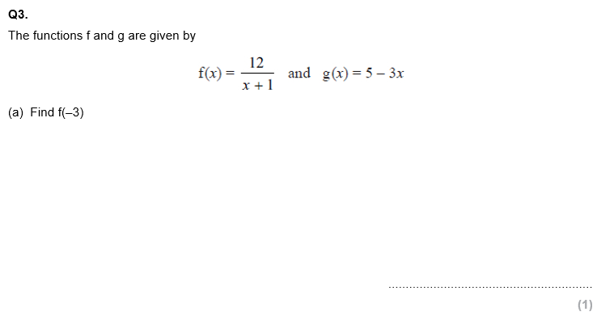
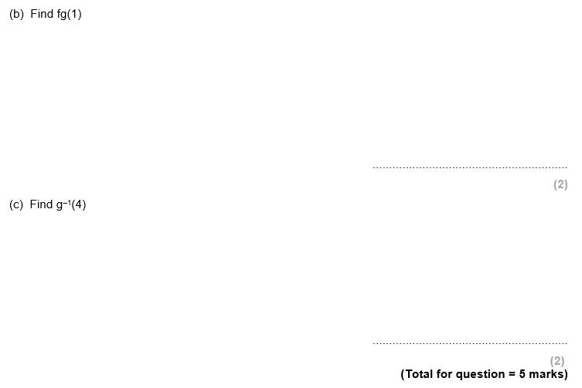
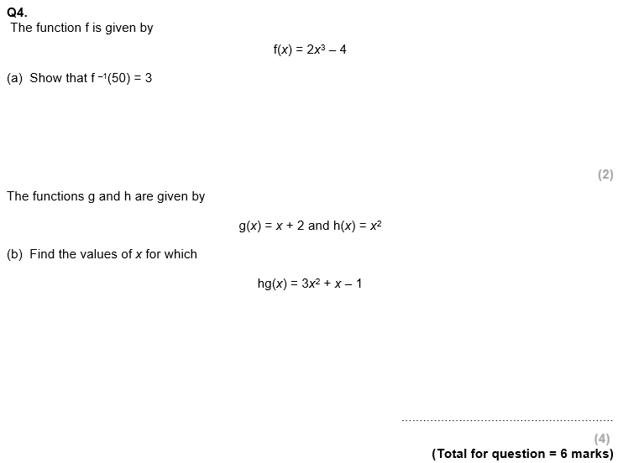

Slide 15
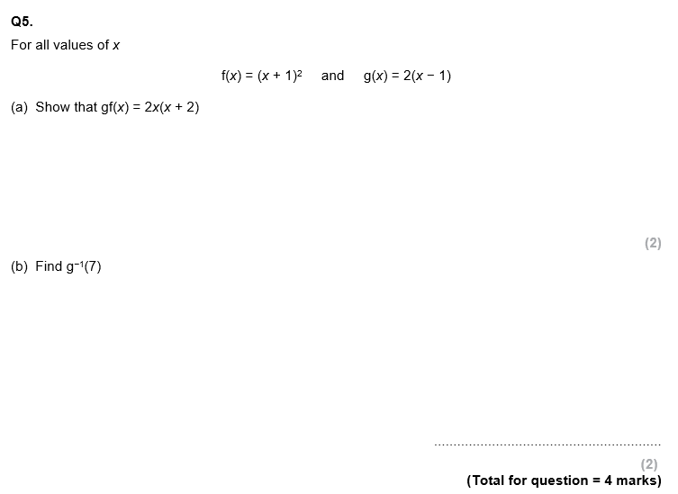
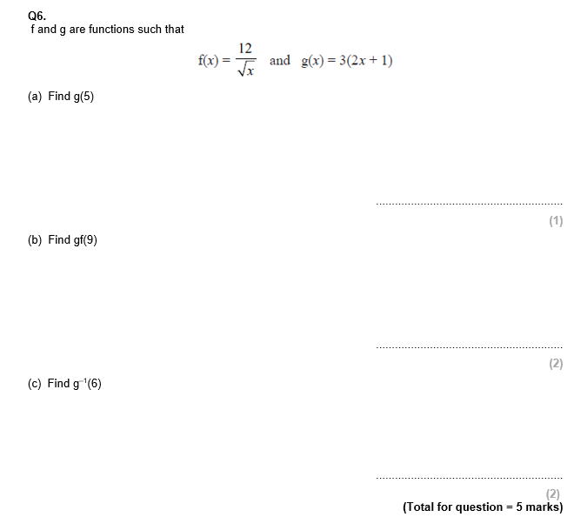

Slide 16
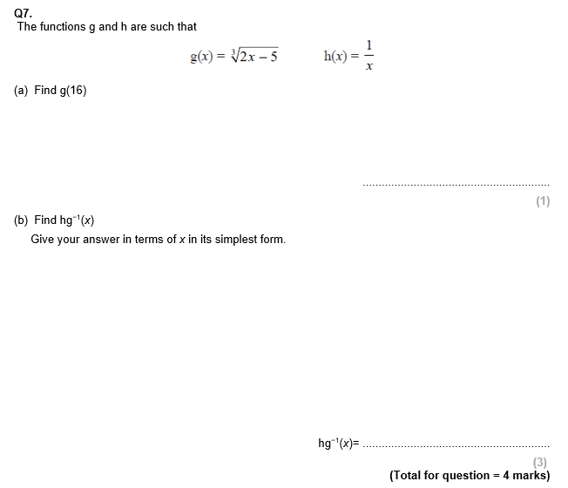
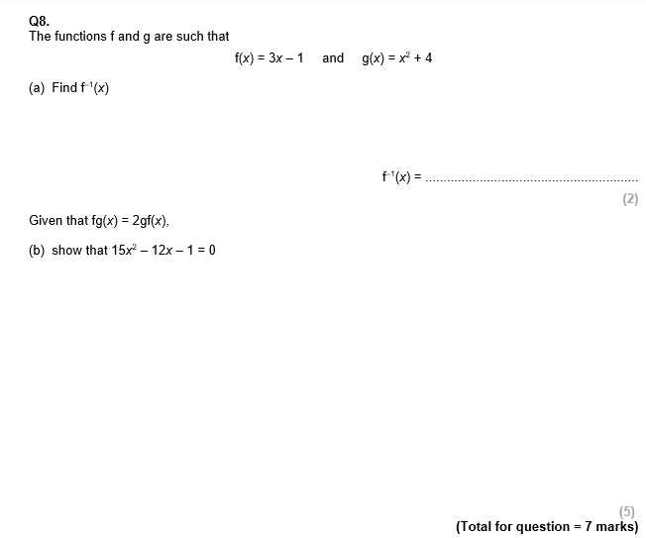

Slide 17



